Slide 1
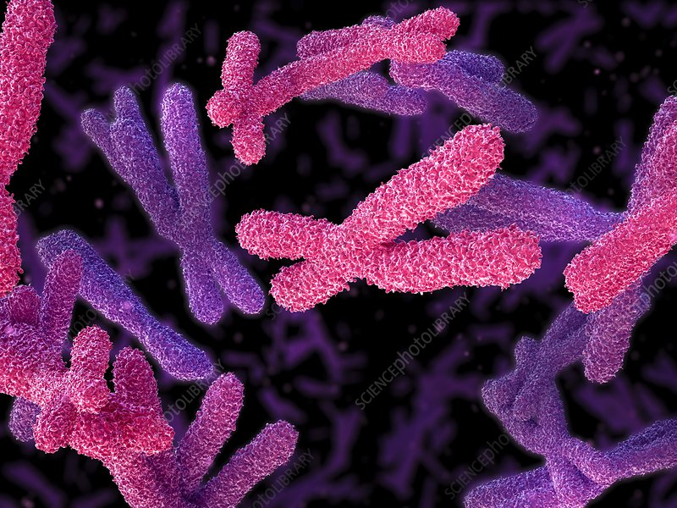
STRUCTURE AND FUNCTION OF CHROMOSOMES
&
CONCEPT OF GENE

Slide 2
WHAT IS A CHROMOSOME?
Greek words “chroma” meaning color and “soma” meaning body
Chromosomes are structures that contain genetic material.
They are complexes of DNA and proteins.
In prokaryotes, DNA is organised into a single circular chromosome that resides in nucleoid.
In eukaryotes, DNA is divided into multiple linear chromosomes that are located inside the nucleus (of both animal and plant cells).
Notes:
The term chromosome comes from the Greek words for color (chroma) and body (soma).
Scientists gave this name to chromosomes because they are cell structures, or bodies, that are strongly stained when colorful dyes are applied to them
genetic material = material that carries all the information needed by a cell grow, thrive, and reproduce.
Chromatin = complex of DNA & proteins, highly uncoiled, condenses (repeated foldings) during PROPHASE to form chromosome.
So while the chromatin is a lower order of DNA organization, chromosomes are the higher order of DNA organization.
The number of chromosomes per organism is always a definite number.
Name of the organism Chromosome no
Human beings 46
Onions 16
Cat 38
Corn 20

Slide 3
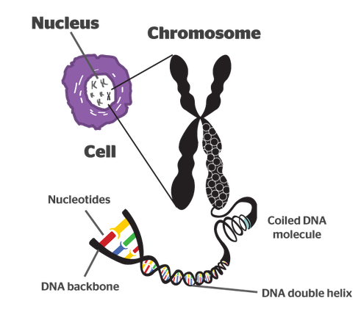
What is inside the chromosomes……….
Notes:
Without such packaging, DNA molecules would be too long to fit inside cells.
For example, if all of the DNA molecules in a single human cell were unwound from their histones and placed end-to-end, they would stretch 6 feet.

Slide 4
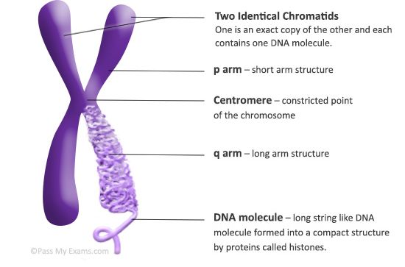
Structure of a chromosome
Telomeres: Tips of chromosome
Notes:
All linear chromosomes have 2 arms - the p (short) arm and the q (long) arm - that are separated from each other by a primary constriction, the centromere.
What are centromeres?
The constricted region of linear chromosomes is known as the centromere. It is the point at which the chromosome is attached to the spindle during cell division.
What are telomeres?
Telomeres are repetitive stretches of DNA located at the ends of linear chromosomes. They protect the ends of chromosomes (from degradation and interchromosomal fusion) in a manner similar to the way the tips of shoelaces keep them from unraveling.
In many types of cells, telomeres lose a bit of their DNA every time a cell divides. Eventually, when all of the telomere DNA is gone, the cell cannot replicate and dies.
Telomeres also play a role in cancer. The chromosomes of malignant cells usually do not lose their telomeres, helping to fuel the uncontrolled growth that makes cancer so devastating.
***********************************************************************************************************************************************************************************NOT REQUIRED*******************************************************
Progressive shortening of telomeres leads to senescence, apoptosis, or oncogenic transformation of somatic cells, affecting the health and lifespan of an individual.
Shorter telomeres have been associated with increased incidence of diseases and poor survival.
Telomerase activity, the ability to extend telomeres, is present in germline and certain hematopoietic cells, whereas somatic cells have low or undetectable levels of this activity and their telomeres undergo a progressive shortening with replication.Telomerases are reactivated in most cancers and immortalized cells.
Telomerase is active in normal stem cells, in gametes and most cancer cells, but is normally absent from, or at very low levels in, most somatic cells.

Slide 5
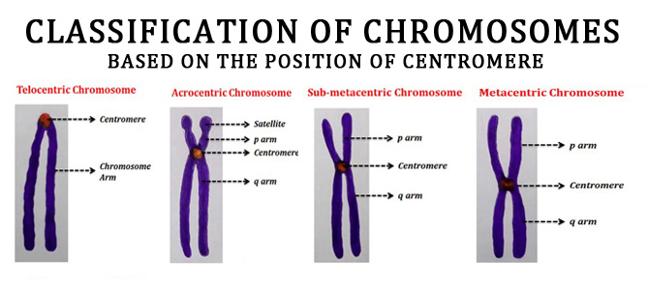
Types of chromosomes

Slide 6
Chromosome types based on centromere position
Telocentric – no p arm; centromere is on end.
Acrocentric – very small p arm; centromere is very near to the end.
Submetacentric – p arm just a little smaller than q arm.
Metacentric – p and q arms are exactly the same length; centromere in exact middle of chromosome.

Slide 7
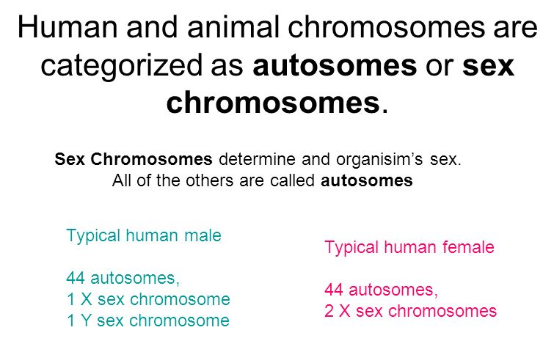
AUTOSOMES & ALLOSOMES
Notes:
Chromosomes can be categorized in two categories –
(i) Autosomes and (ii) Allosomes (sex chromosomes).
Autosomes
Chromosomes that do not determine the sex of the individual, i.e., all the chromosomes other than the sex chromosomes are autosomes.
They exist in pairs in the somatic cells whereas singly in the gametic cells.
They carry genes that control somatic traits.
Each pair of autosomes is identical morphologically, i.e., both the chromosome in the pair appear in similar forms.
(Somatic traits: body weight, chest size, and hip breadth, skin color etc)
ALLOSOMES
Chromosomes that determine the sex of the individual are allosomes.
Both the chromosomes in the pair can be similar (XX) or different (XY) from each other.
In case of human diploid genome, there are 44 autosomes (22 pairs) and 2 allosomes (in female - XX and male - XY chromosome).

Slide 8
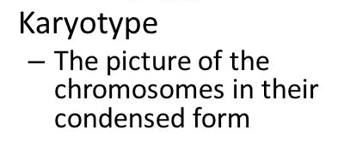
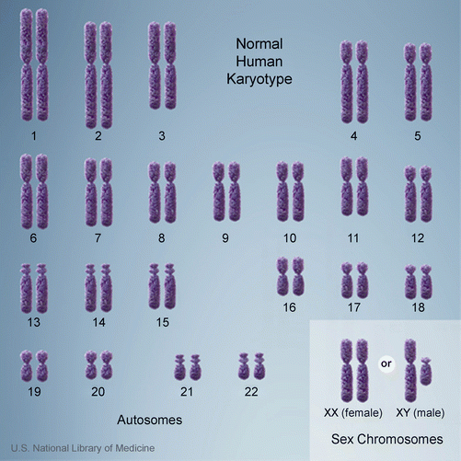
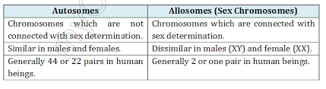
DIFFERENCE BETWEEN AUTOSOMES & ALLOSOMES

Slide 9


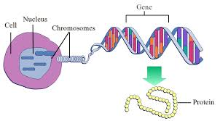
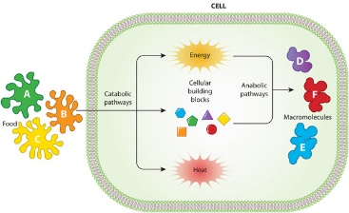
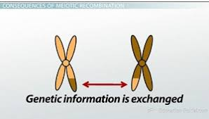
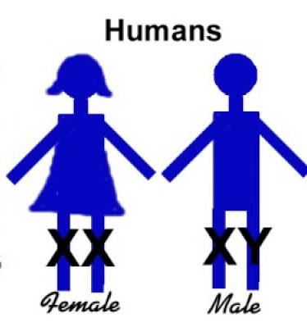
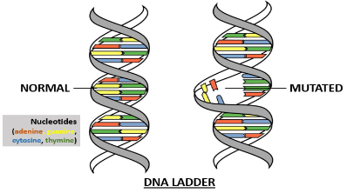
Functions of chromosomes
Chromosomes contain genes and all the hereditary information is located in the genes.
Chromosomes control the synthesis of structural proteins and thus help in cell division and growth.
They control cellular differentiation.
By directing the synthesis of particular enzymes, chromosomes control cell metabolism.
Chromosomes form link between off springs and parents.
Some chromosomes called as sex chromosomes determine the sex of the individuals.
Through the process of crossing-over, chromosomes introduce variations.
Mutations are produced due to changes in gene chemistry.

Slide 10
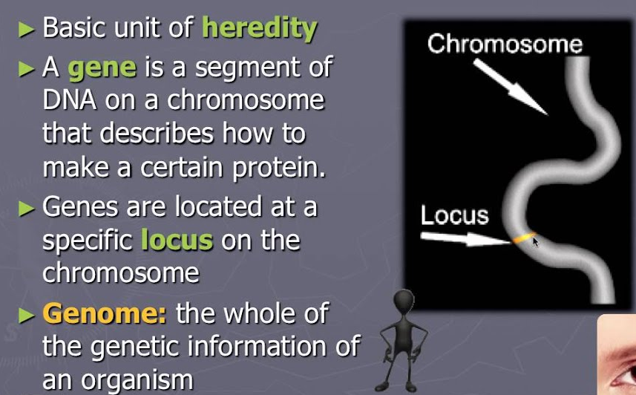
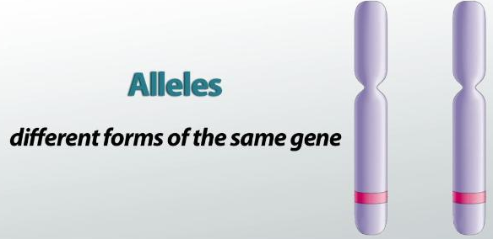
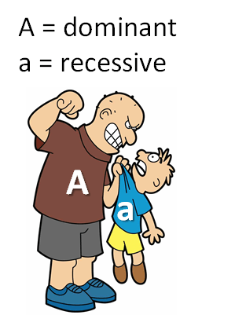
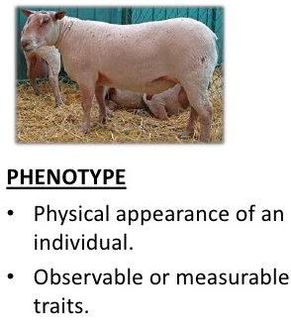
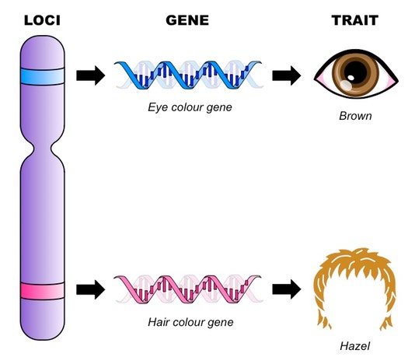
GENES
The characteristic associated with a certain allele can sometimes be dominant or recessive
An individual’s phenotype is determined by the combination of alleles they have.

Slide 11
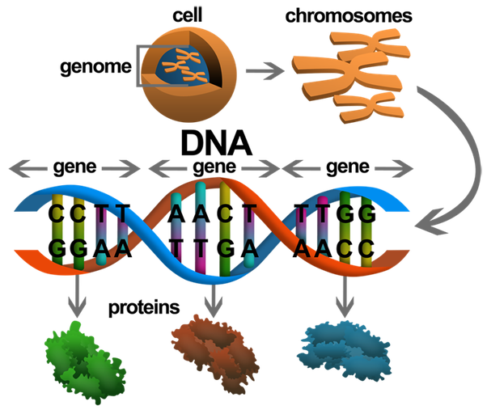
How do genes work ?
Each gene has a special job to do. The DNA in a gene spells out specific instructions—much like in a cookbook recipe — for making proteins
Notes:
DNA contains the information needed to make all of our proteins, and RNA is a messenger that carries this information to the ribosomes. The ribosomes serve as factories in the cell where the information is‘translated’from a code into the functional product, i.e., protein.

Slide 12
QUESTIONS
What is a chromosome? List the important functions of chromosome.
Draw a well-labeled diagram of a chromosome.
What are the different types of chromosome based on the position of centromere?
State the difference between autosomes and allosomes
What is a gene?
What are alleles? State the difference between dominant and recessive alleles.

